Slide 1
Machine Learning with Python
Varun Aravinth

Slide 2

Why Python ?
Easy Syntax
Modules : Do anything
And it gives you wings

Slide 3
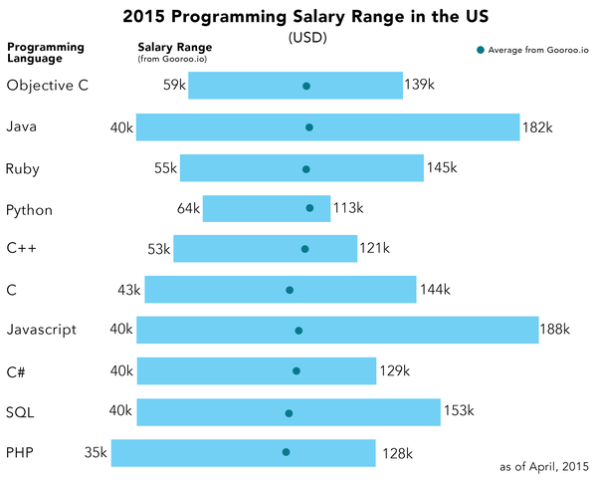
Market Demand 2015

Slide 4

Things I did using python
Pygame
Browser automation
Web crawling
Excel automation
https://github.com/VarunAravinth

Slide 5
Web Scraping

Slide 6
Why Scraping ?
The data available over the internet now is huge. More Data, more information.
A Python web scraping code (called as the spider code) can be built based on the webpage’s skeleton to extract the content from the respective website.
We have developed such a sample spider code for the following site: www.checkatrade.com
This site contains all the useful information about the various builders available across the UK, along with the services they provide.

Slide 7
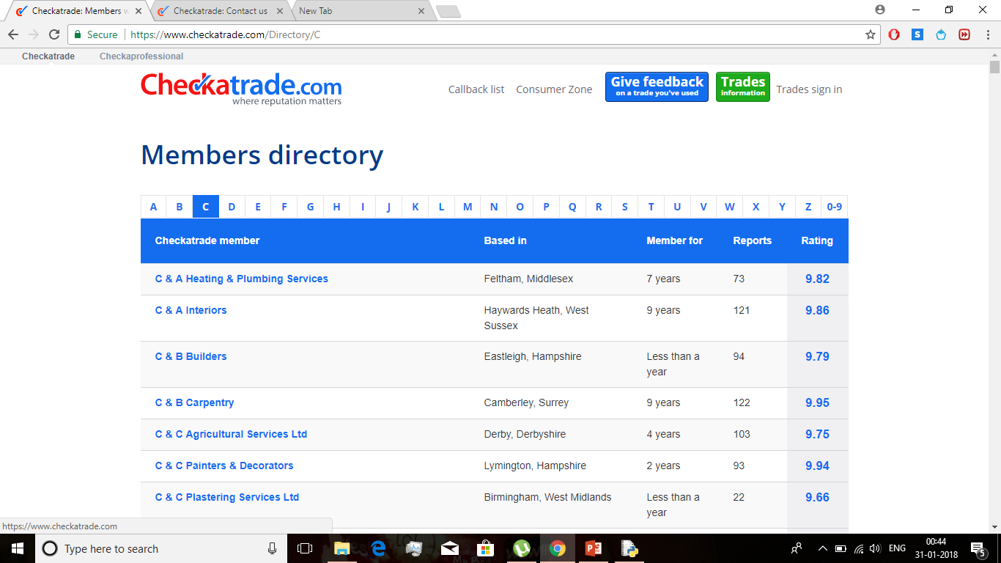
This is the sample site we chose, to pull the content from.
Note: There were over 2000 records under each alphabet, so this site has around 2000 * 26 = 52000 companies details.

Slide 8
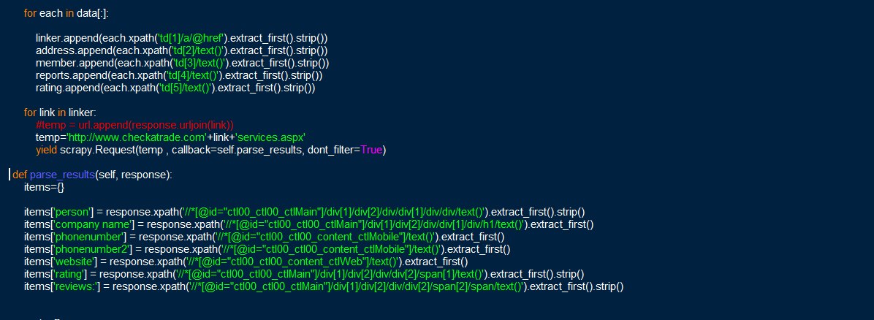
We captured the required elements from the website using Xpath selector, and also wrote a crawler code, which crawls after completing one page to another, till it reaches the last page.

Slide 9
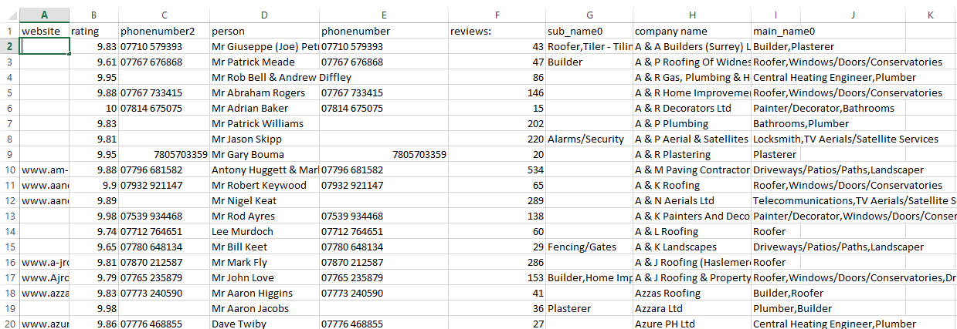
The final output of the spider code will be a csv file [ note : can be a json file if required], with the data as shown in the table.

Slide 10
The data obtained from such websites can be used in many ways.
The following output file can be used to feed into another system for processing and filtering various companies which can do the respective work and has a good review.
NOTE : As shown for this sample site, the following can be done for many websites which contain much more important information and be processed in an effective way.

Slide 11
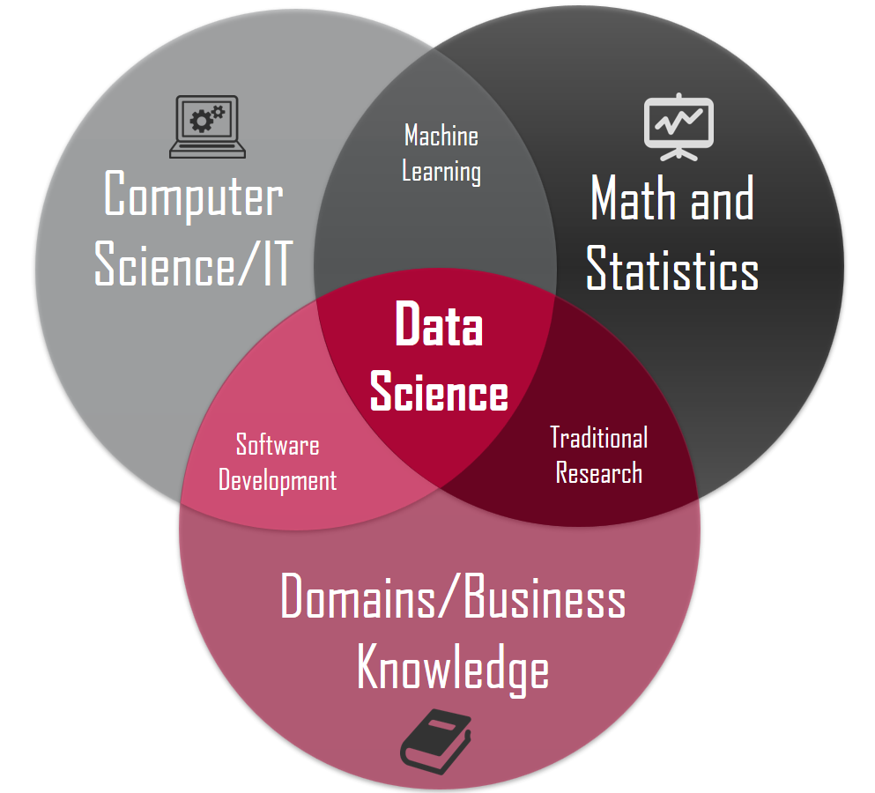
Data Science | Machine Learning | Artificial Intelligence

Slide 12

Machine Learning !
Informal :
"the field of study that gives computers the ability to learn without being explicitly programmed."
Formal:
"A computer program is said to learn from experience E with respect to some class of tasks T and performance measure P, if its performance at tasks in T, as measured by P, improves with experience E."
Example: playing checkers.
Types:
Supervised | Unsupervised

Slide 13

Real Example !
Bank Of America
Spending millions and saving billions.
Cool Project ☺

Slide 14
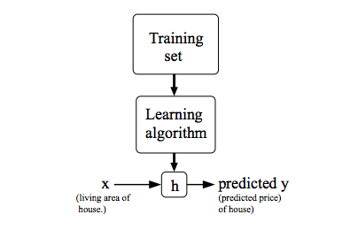
Models which we will be developing
Cost Function

Slide 15
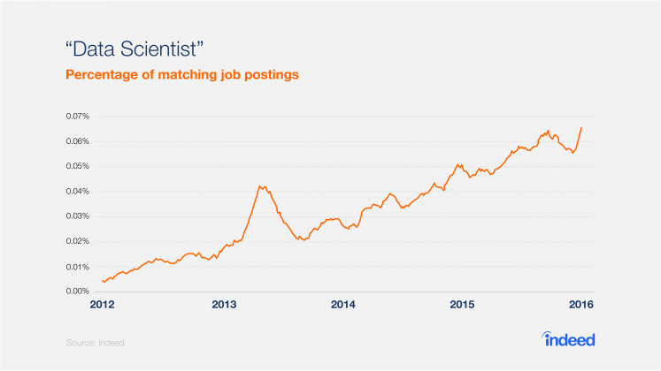
Market Demand – Data Scientist

Slide 16
Data Science - Introduction
NumPy – Numeric Python
NumPy is a Python package. It stands for 'Numerical Python'. It is a library consisting of multidimensional array objects and a collection of routines for processing of array.
Numeric + Numarray
Why NumPy when you have lists ?
Detail Analysis
Datasets for NumPy

Slide 17
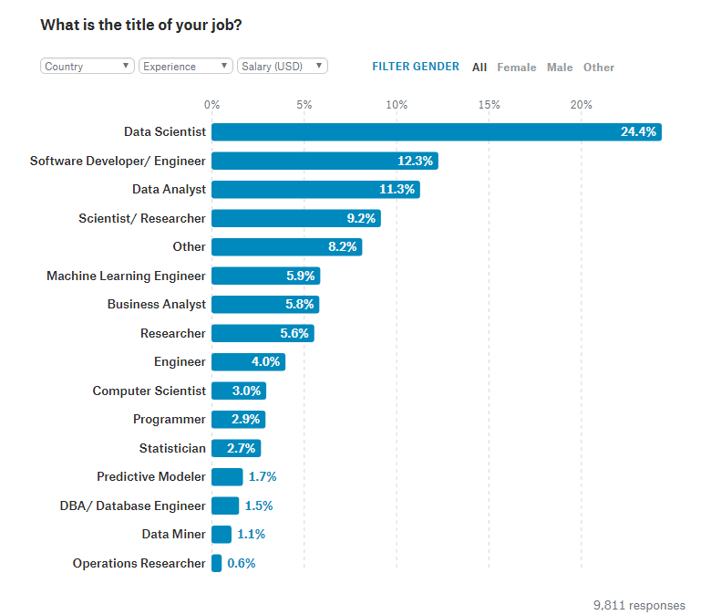
Data Scientist PayScale

Slide 18

https://github.com/VarunAravinth
Thank You

